Slide 1


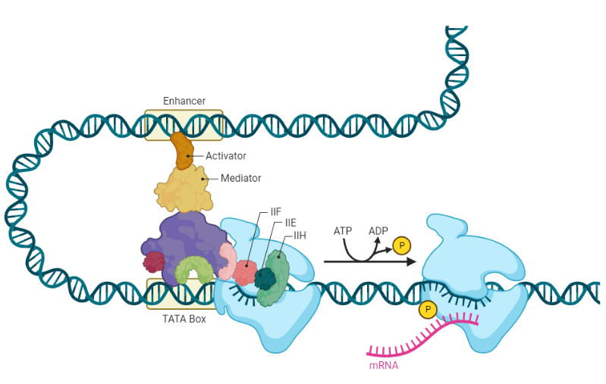
The role of enhancers in the early stages of monocyte-to-macrophage differentiation
Yi Xu
Supervisor: Nikki Gentle
Co-supervisor: Vanessa Meyer

Slide 2
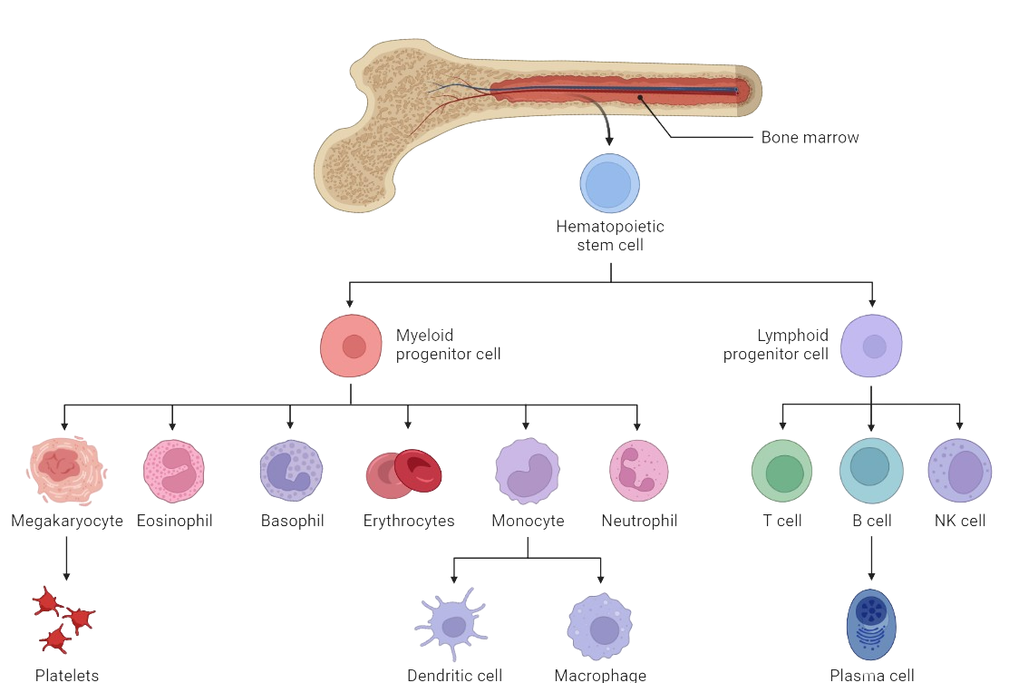
01
Differentiation of cells
Notes:
Immune system forms the line of defense for the human body against foreign infection and injuries through incorporating a network of immune cells.
All these involved immune cells originates from the bone marrow through different level of differentiation of the hematopoietic stem cell.

Slide 3
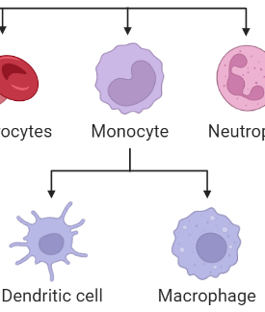
01
Differentiation of cells
Notes:
To allow the protection of local tissues, certain immune cells, such as macrophages and DC will stay in local tissues and lead to the lose of motility.
Additionally, to accommodate with the needs in local immunity, these cells still need to replenish their number through the differentiation of monocytes into these local immune cells.

Slide 4
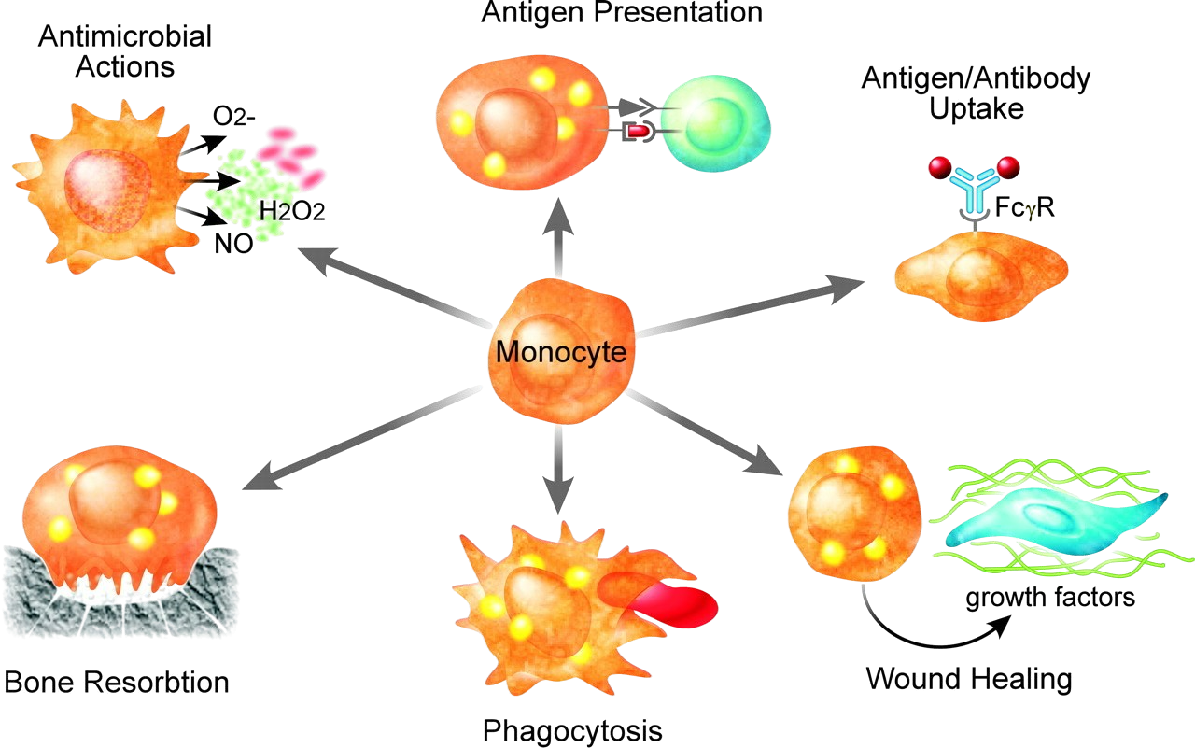
01
Monocyte-to-macrophage differentiation
(Chawla, 2010)
Notes:
So one of the particularly interesting process is the differentiation of monocytes into macrophages which provides the innate immunity for local tissues for processes such as wound healing and also antigen presentration and phagocytosis which can be inherited from the monocytic functionality.

Slide 5
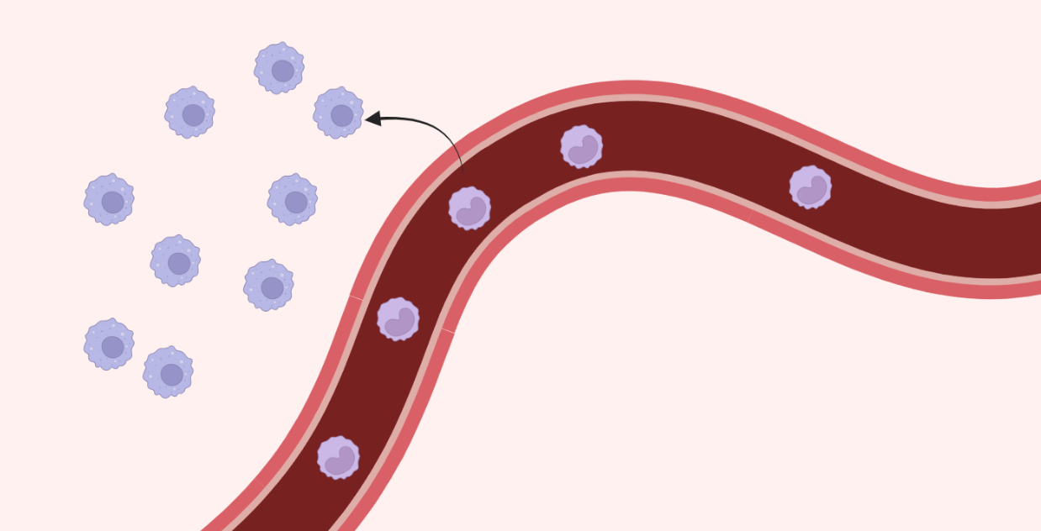
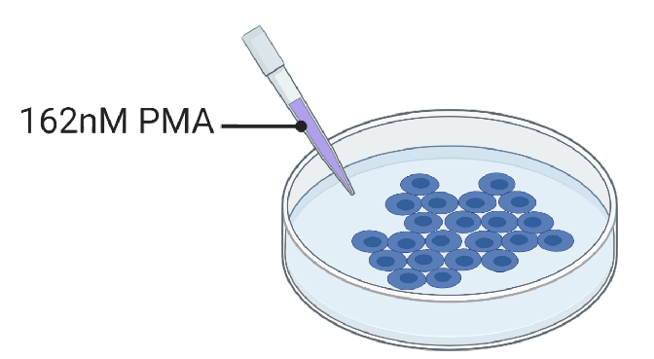
01
Monocyte-to-macrophage differentiation
Epigenetic reprogramming impacting regulatory elements (enhancer and promoter)
GM-CSF /
M-CSF
Phorbol myristate acetate (PMA)
Notes:
In order to study the differentiation between monocytes and macrophages, researchers has developed in vitro models to study the process which PMA treatment were used for the induction of differentiation process. This differentiation process has shown to correlate with an epigenetic reprogramming impacting on regulatory elements such enhancers and promoters.

Slide 6
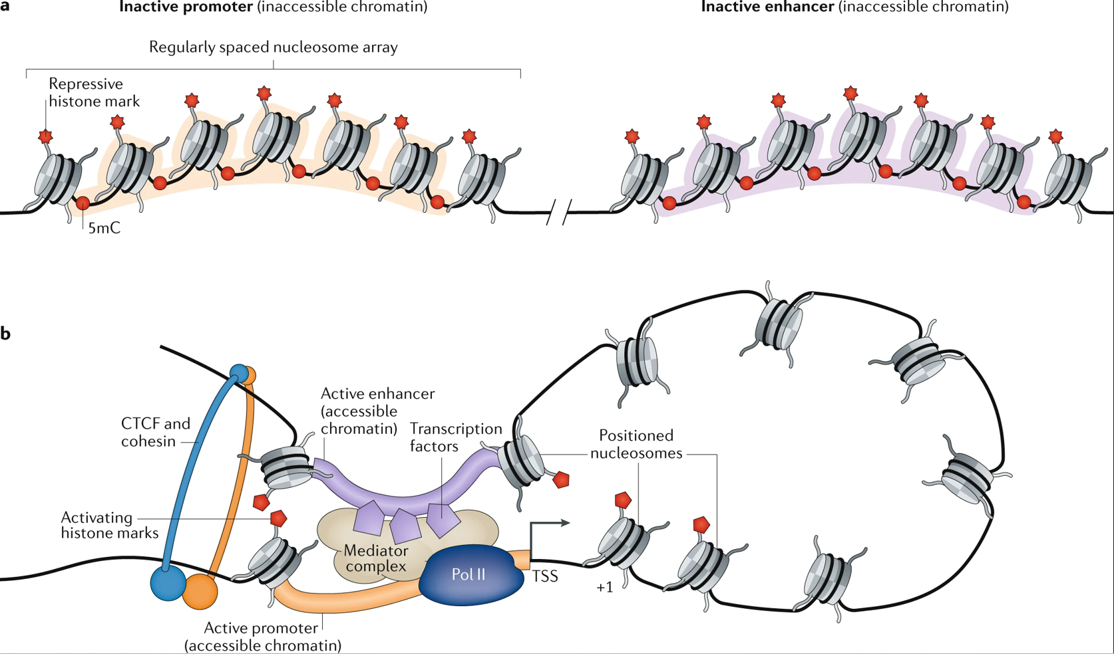
01
Regulation of enhancer activities during monocyte differentiation
Enhancer-promoter crosstalk
(Carter, B. and Zhao, K., 2021)
Notes:
Enhancers are known to function primarily through the formation of enhancer promoter crosstalk allows the crosstalk bridge leading to significantly upregulation in gene expression. However, when either one od the promoter or enhancer shows to be inaccessible, the crosstalk will not be formed leading to a low or loss of gene expression.

Slide 7
02
Aim and Objectives
Identify differential expressed genes (DEGs)
01
Investigate the role of enhancer during early monocyte-to-macrophage differentiation
Identify regions with a change in chromatin accessibility
02
03
DEGs with an enhancer experiencing chromatin accessibility changes

Slide 8
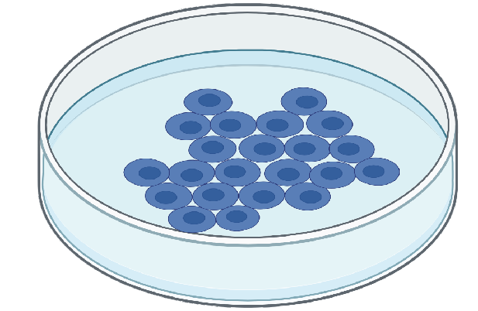
03
Sample preparation and collection
Untreated THP-1 cells
(24 hour)
Treated THP-1 cells
(Kr et al., 2020)
Notes:
In order to perform this study, we collected PMA treated sample sets from publicly available datasets. The dataset includes THP-1 promonocytic cells treated with 24hour PMA allowing a early stage of monocyte to macrophage differentiation status to be can be accomplished.

Slide 9
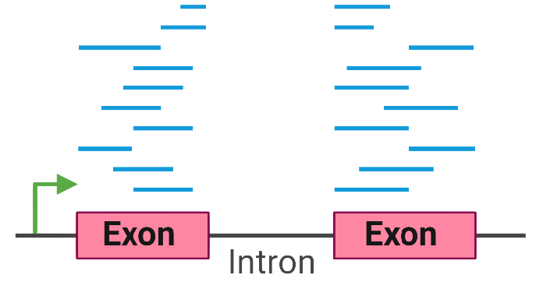

03
Sample preparation and collection
Untreated THP-1 cells
Differential Expression Analysis
(24 hour)
Differential Accessibility Analysis
Treated THP-1 cells
(Kr et al., 2020)
Notes:
The dataset been provided includes the RNA sequencing results and ATAC sequencing separately allows us to perform the differential expression analysis and analysis region experience accessibility changes separately.

Slide 10
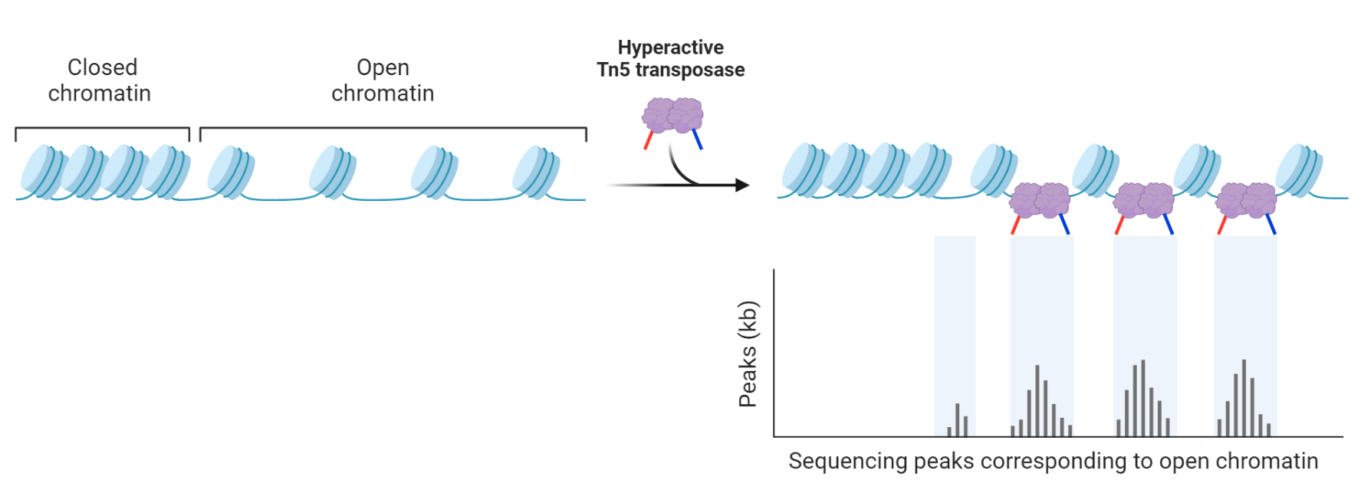
03
Assay for Transposase-Accessible Chromatin with sequencing (ATAC-seq)

Slide 11
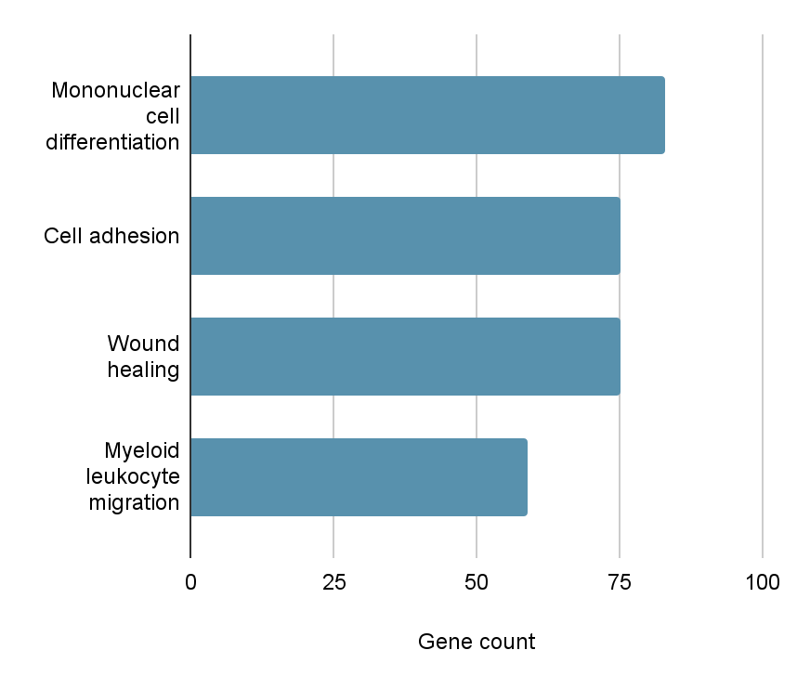
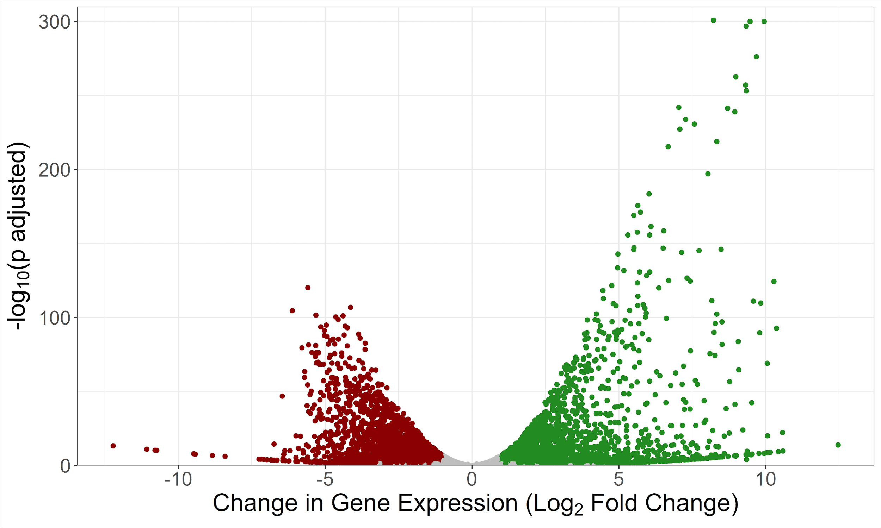
04
2870 differential expressed genes (DEGs) due to PMA treatment
2870 differential expressed genes with 1436 upregulated and 1434 downregulated

Slide 12
04
Accessibility of promoters during PMA treatment
Promoter region = 1kb upstream of TSS

Slide 13
04
Accessibility of enhancers during PMA treatment
Validated enhancer collected from Genhancer database

Slide 14
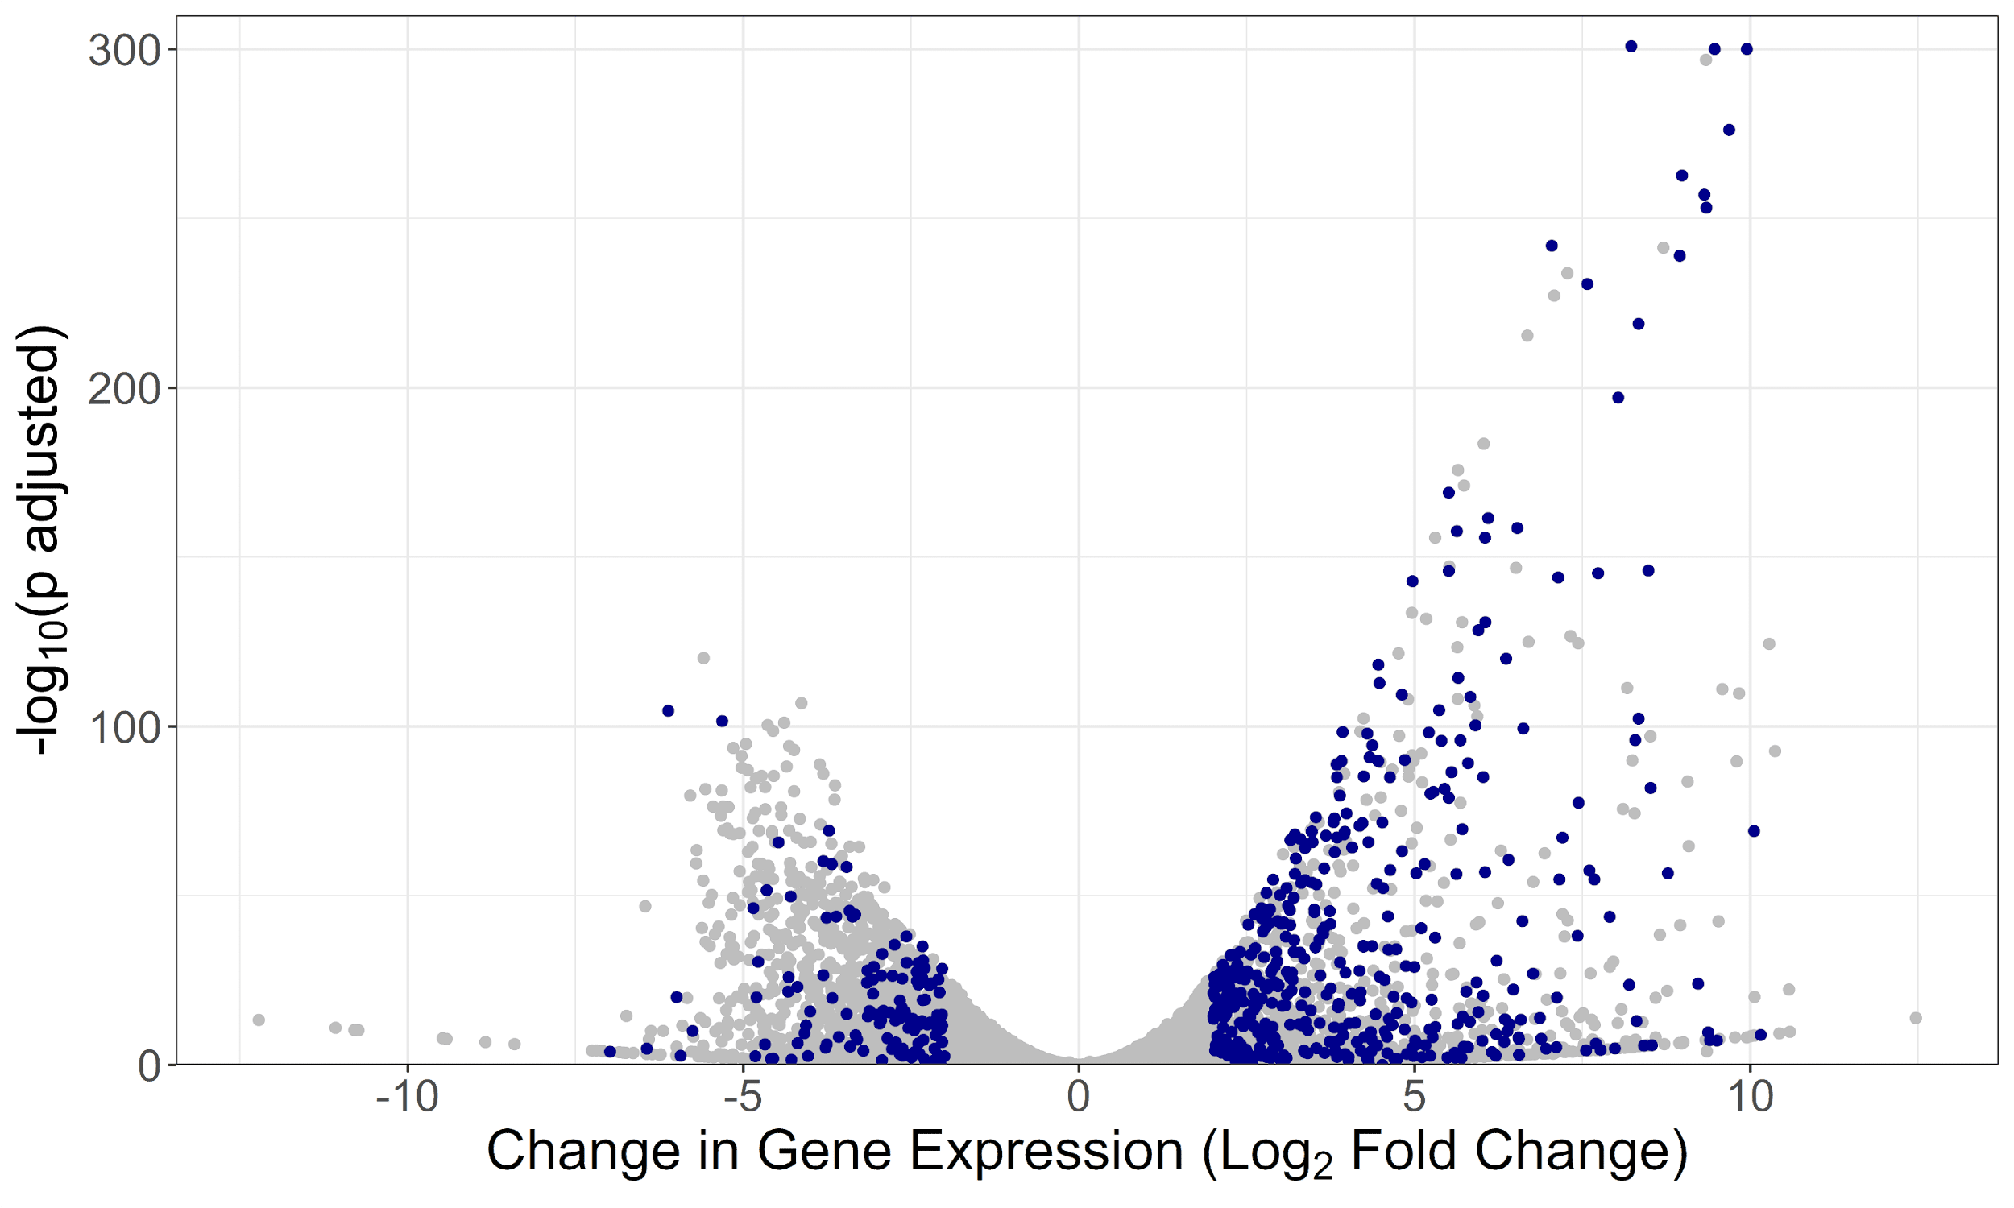
04
542 DEGs shows to contains an accessibility changed enhancer (ACE)
|L2FC| > 2; p.adj < 0.05
2870 Differential expressed genes with 1436 upregulated and 1434 downregulated
542 DEGs with a potential enhancer experiencing accessibility changes

Slide 15
04
Accessibility of the promoter regions for DEGs with ACE
Increase
12.4%
Decrease
86.7%
Constant
86.7%

Slide 16
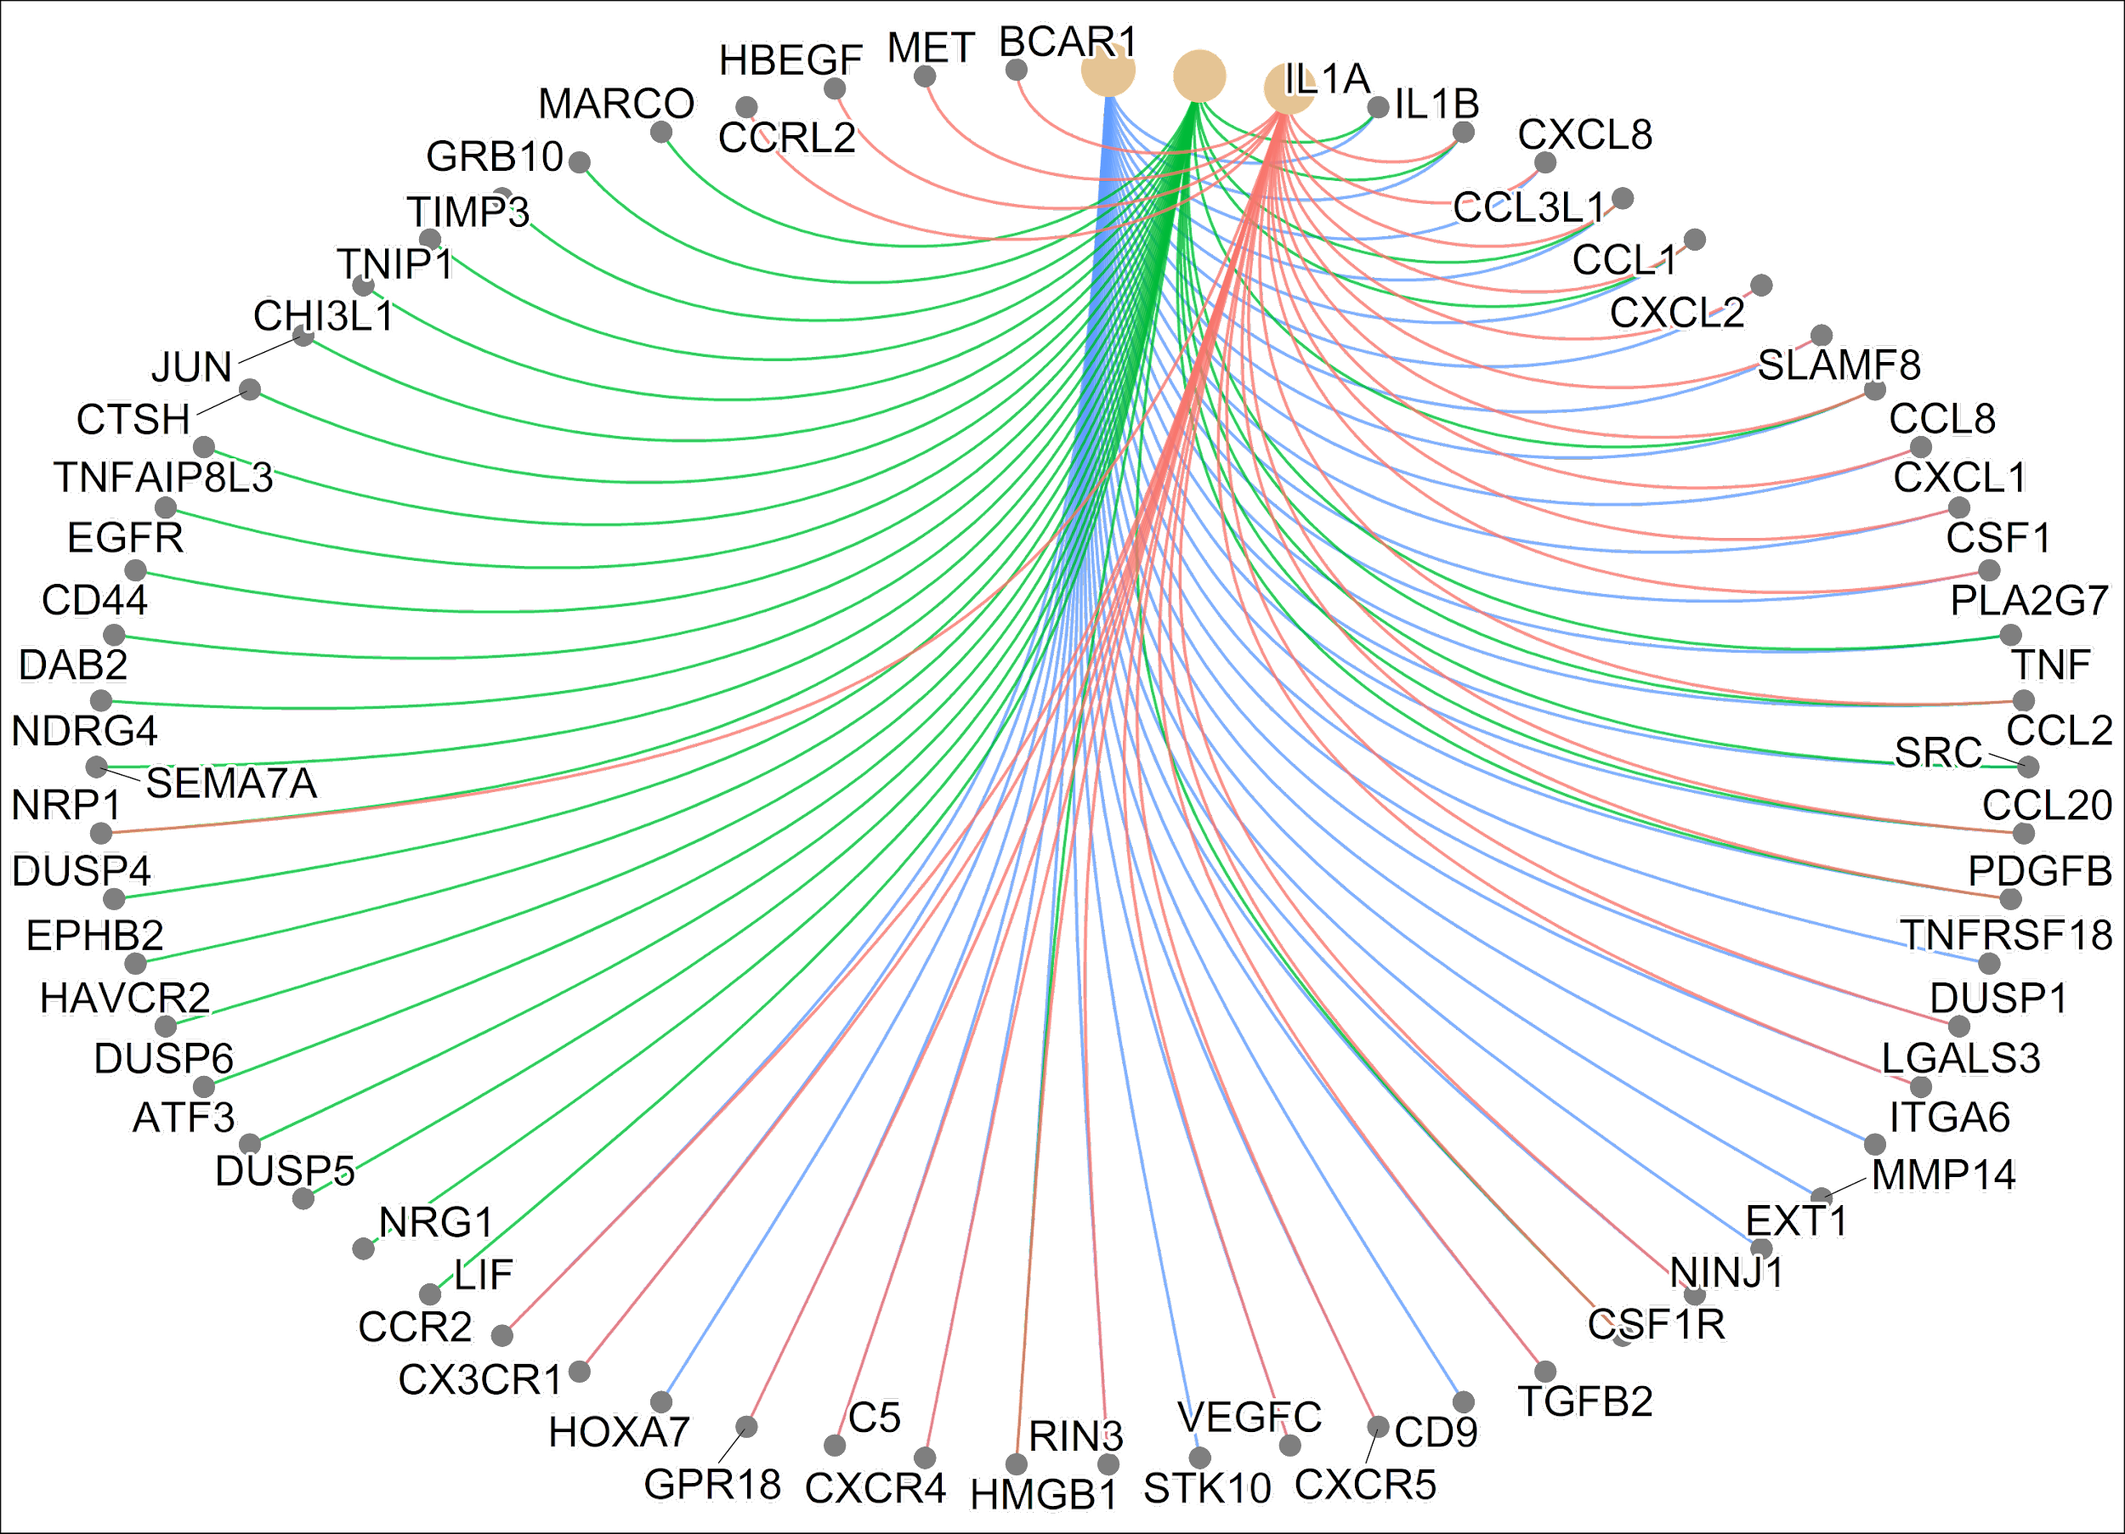
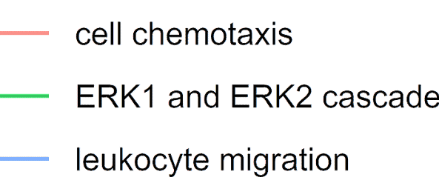
04
DEGs with ACE involved in:
Cell proliferation
Cell differentiation
Function of immune cells

Slide 17
04
DEGs with ACE involved in:
Cell proliferation
Cell differentiation
Function of immune cells

Slide 18
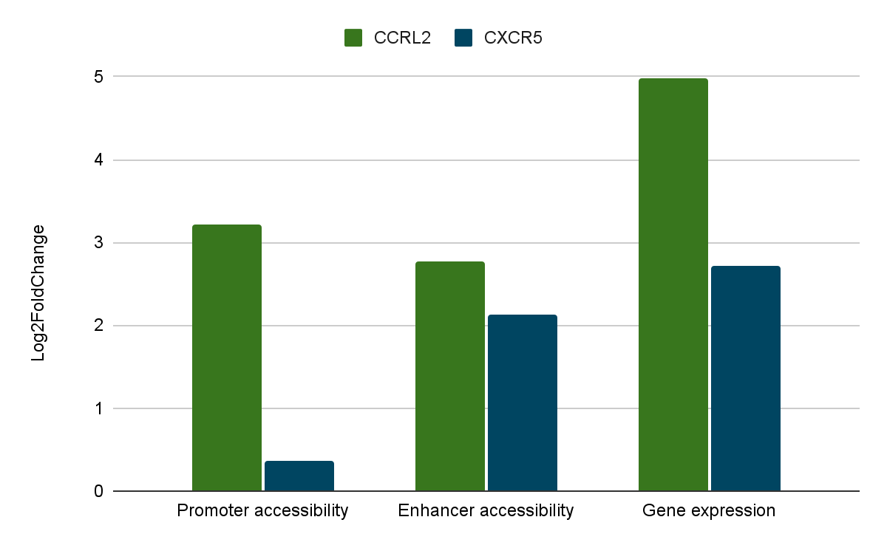
04

Slide 19
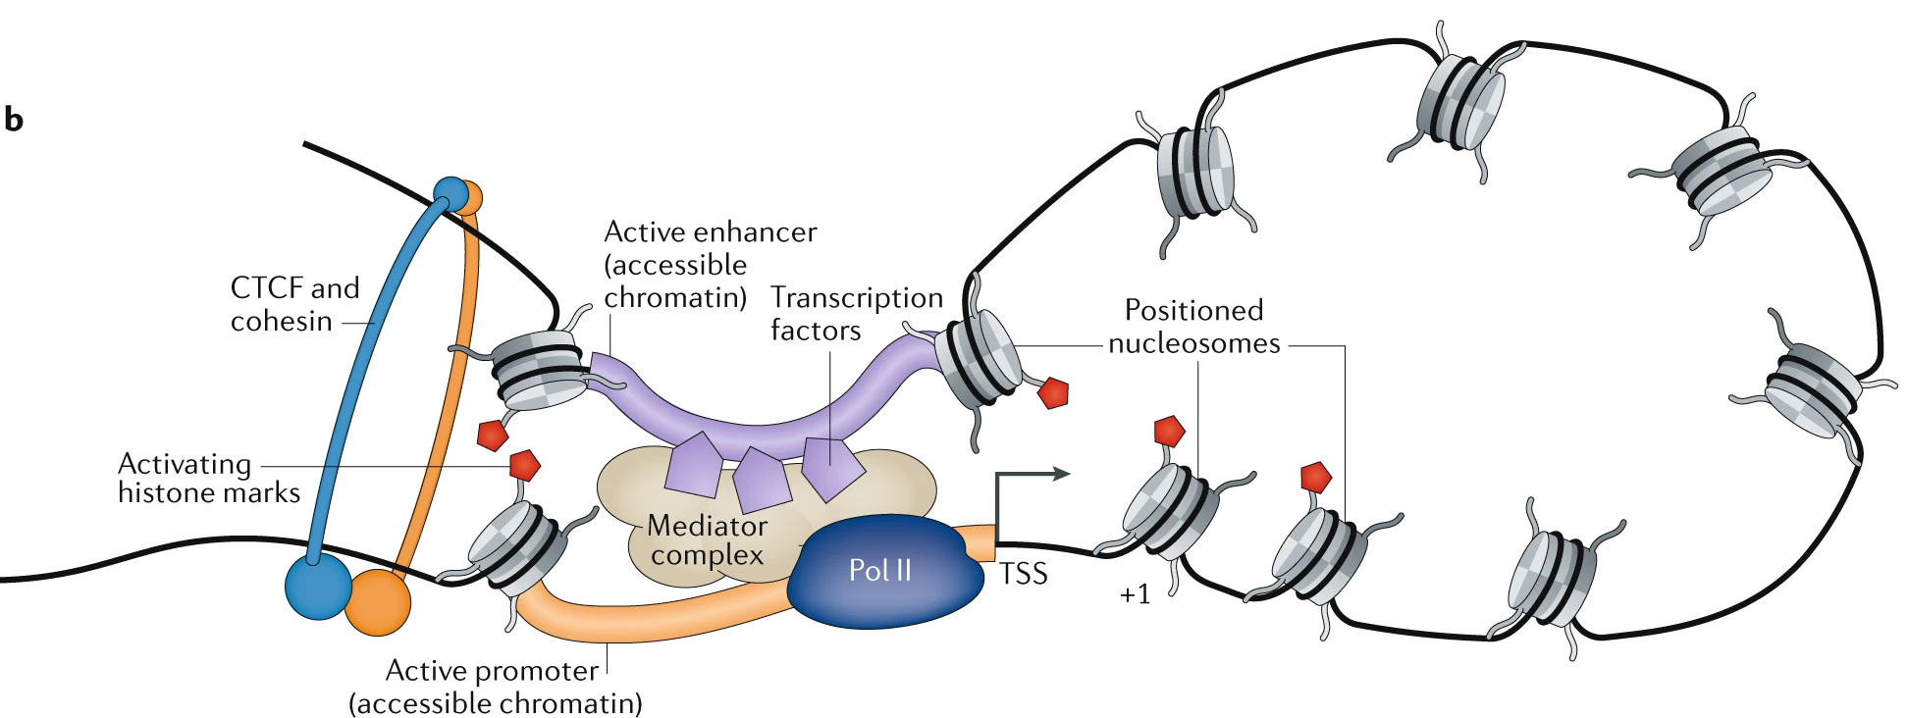
04
DEGs with ACE involved in:
Cell proliferation
Cell differentiation
Function of immune cells

Slide 20
05
Conclusion
Monocyte differentiation are correlated with an epigenetic reprogramming
(Saeed et al., 2014)
We have shown enhancer accessibility are involved in an early stage of monocyte-to-macrophage differentiation
Enhancer activity has shown to be one of the important regulating factor
(Dekkers et al., 2019)

Slide 21
05
Future work
We have shown enhancer accessibility are involved in processes such as wound healing
Future work: techniques involving 3D conformation to verify the interaction between promoter and enhancer

Slide 22

00
Acknowledgement
Dr N. Gentle and Dr V. Meyer
FunGenics Lab
NRF funding

Slide 23
00
Key References
Carter, B. and Zhao, K. (2021). The epigenetic basis of cellular heterogeneity. Nature Reviews Genetics, [online] 22(4), pp.235–250. doi:10.1038/s41576-020-00300-0.
Chawla, A. (2010). Control of Macrophage Activation and Function by PPARs. Circulation Research, [online] 106(10), pp.1559–1569. doi:10.1161/circresaha.110.216523.
Dekkers, K.F., Neele, A.E., Jukema, J.W., Heijmans, B.T. and de Winther, M.P.J. (2019). Human monocyte-to-macrophage differentiation involves highly localized gain and loss of DNA methylation at transcription factor binding sites. Epigenetics & Chromatin, 12(1). doi:10.1186/s13072-019-0279-4.
Kr, B., Be, D., Tj, S., Tj, H., B, C., J, A., Ad, S. and E, H. (2020). ATAC-Me Captures Prolonged DNA Methylation of Dynamic Chromatin Accessibility Loci during Cell Fate Transitions. Molecular cell, [online] 77(6). doi:10.1016/j.molcel.2020.01.004.
Saeed, S., Quintin, J., Kerstens, H.H.D., Rao, N.A., Aghajanirefah, A., Matarese, F., Cheng, S.-C. ., Ratter, J., Berentsen, K., van der Ent, M.A., Sharifi, N., Janssen-Megens, E.M., Ter Huurne, M., Mandoli, A., van Schaik, T., Ng, A., Burden, F., Downes, K., Frontini, M. and Kumar, V. (2014). Epigenetic programming of monocyte-to-macrophage differentiation and trained innate immunity. Science, [online] 345(6204), pp.1251086–1251086. doi:10.1126/science.1251086.

